Slide 1

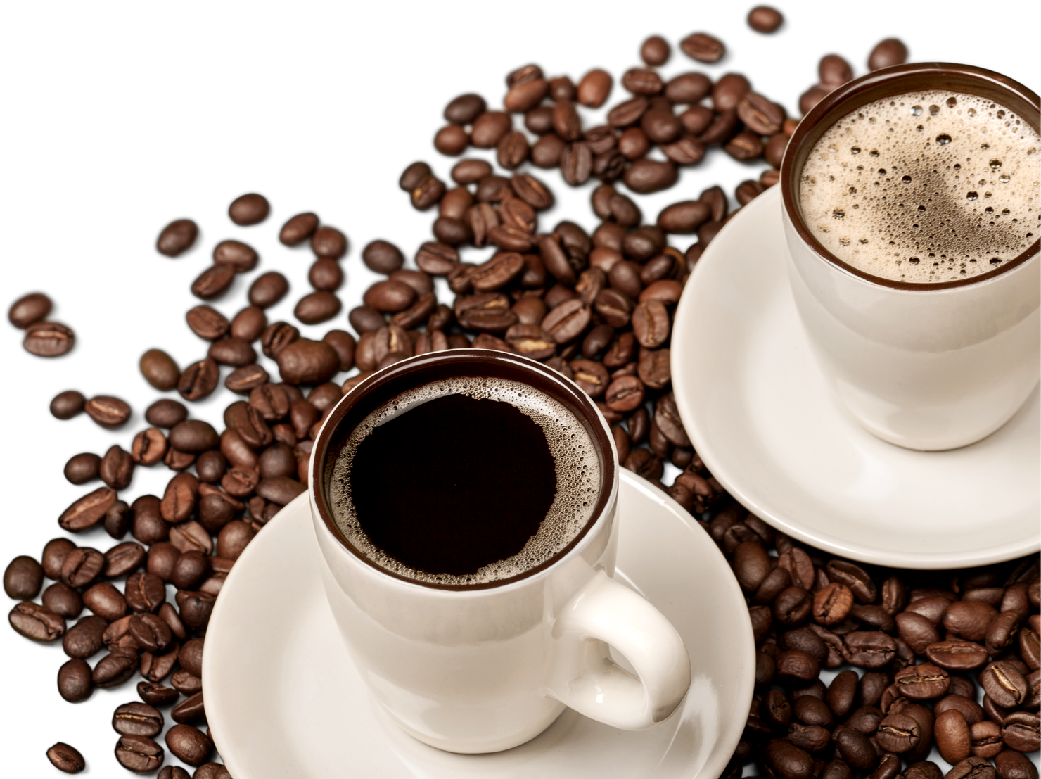

BRIGHT CO
COFFEE SHOPS
Sales Analysis
by
Ebrahim Williams

Slide 2
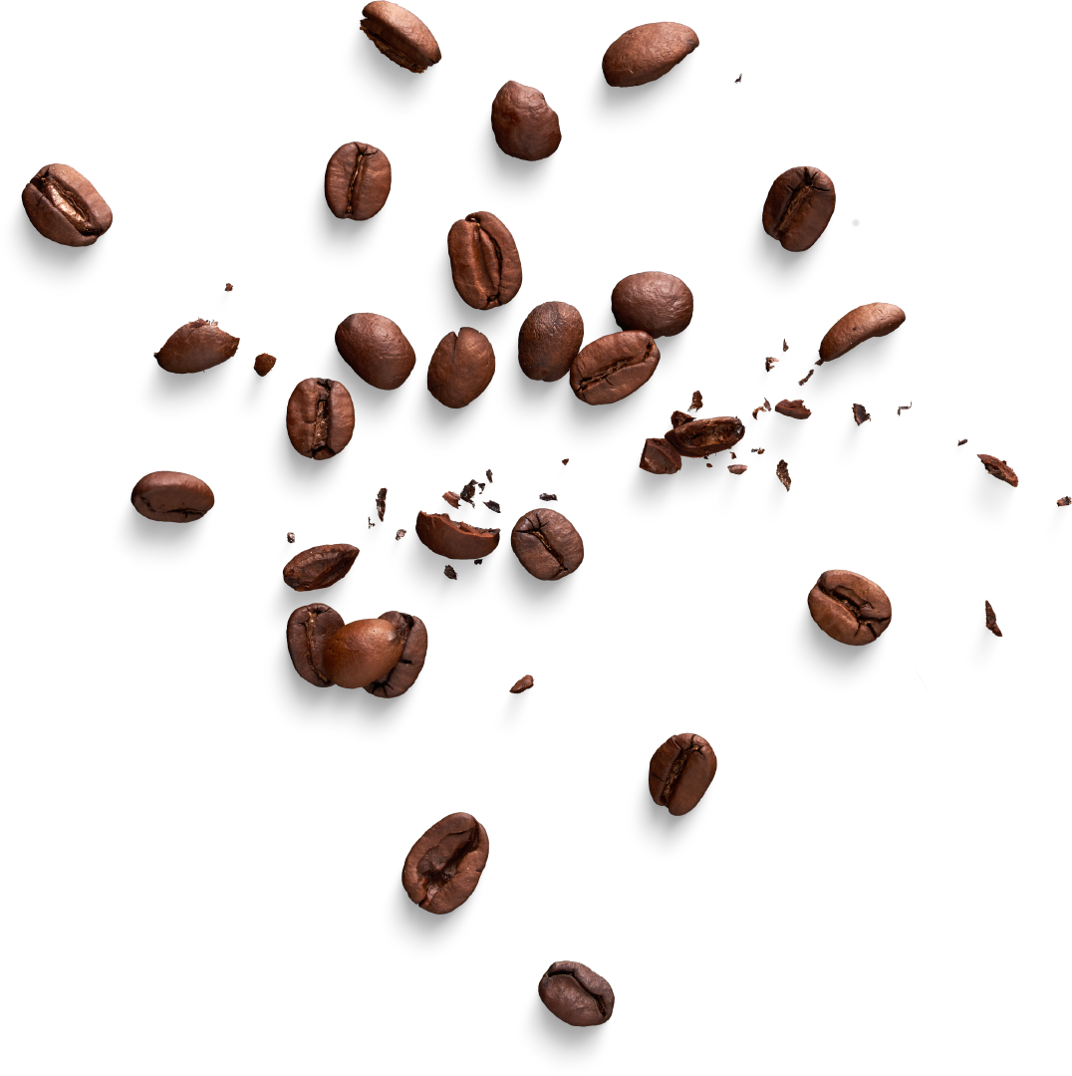
TABLE OF CONTENT
Revenue ...........................04
Sales...........................................07 Products...............................................11 Recommendations.............................................15

Slide 3
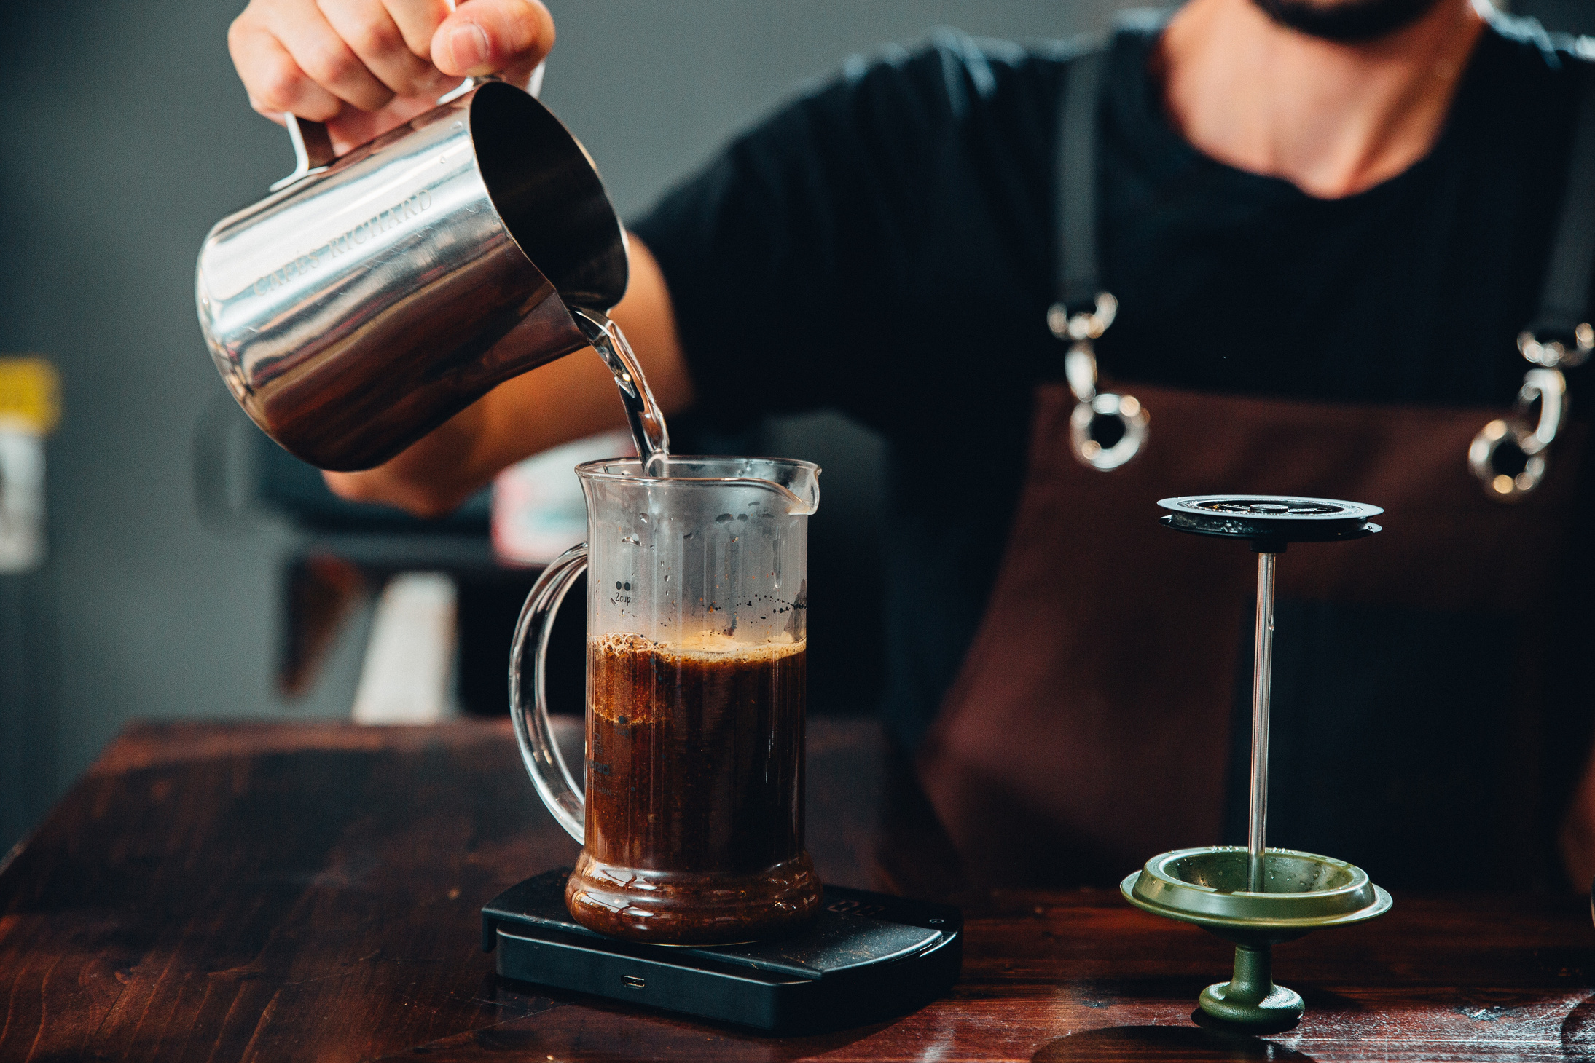
REVENUE
R88. 602
04
Smells So Good
03

Slide 4
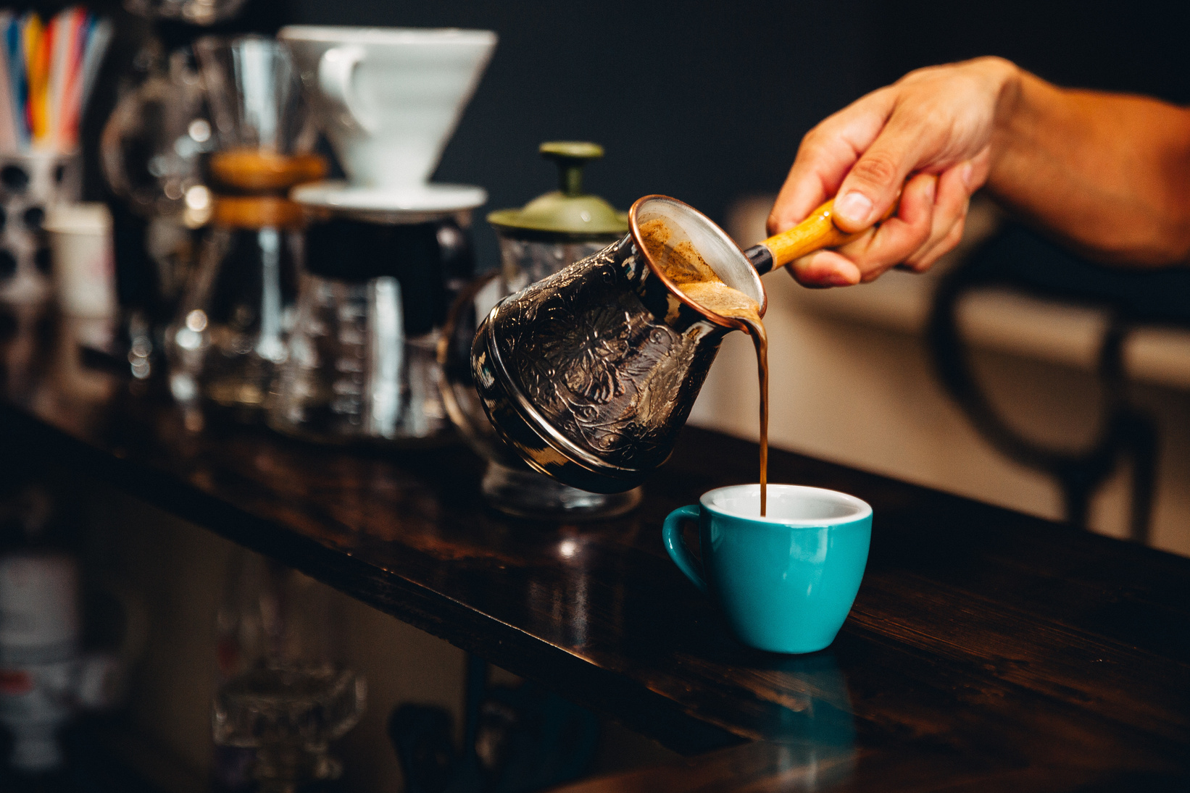
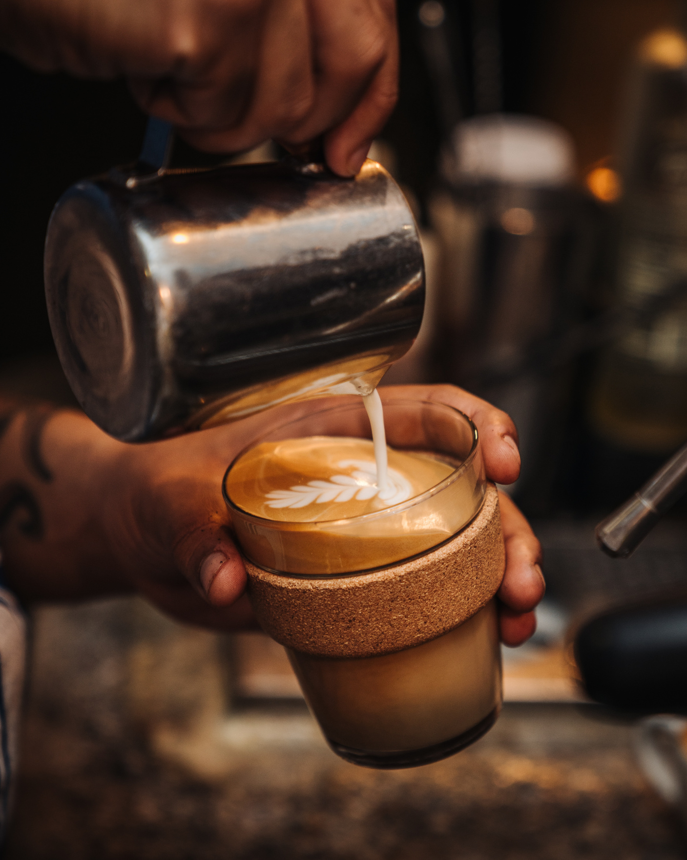
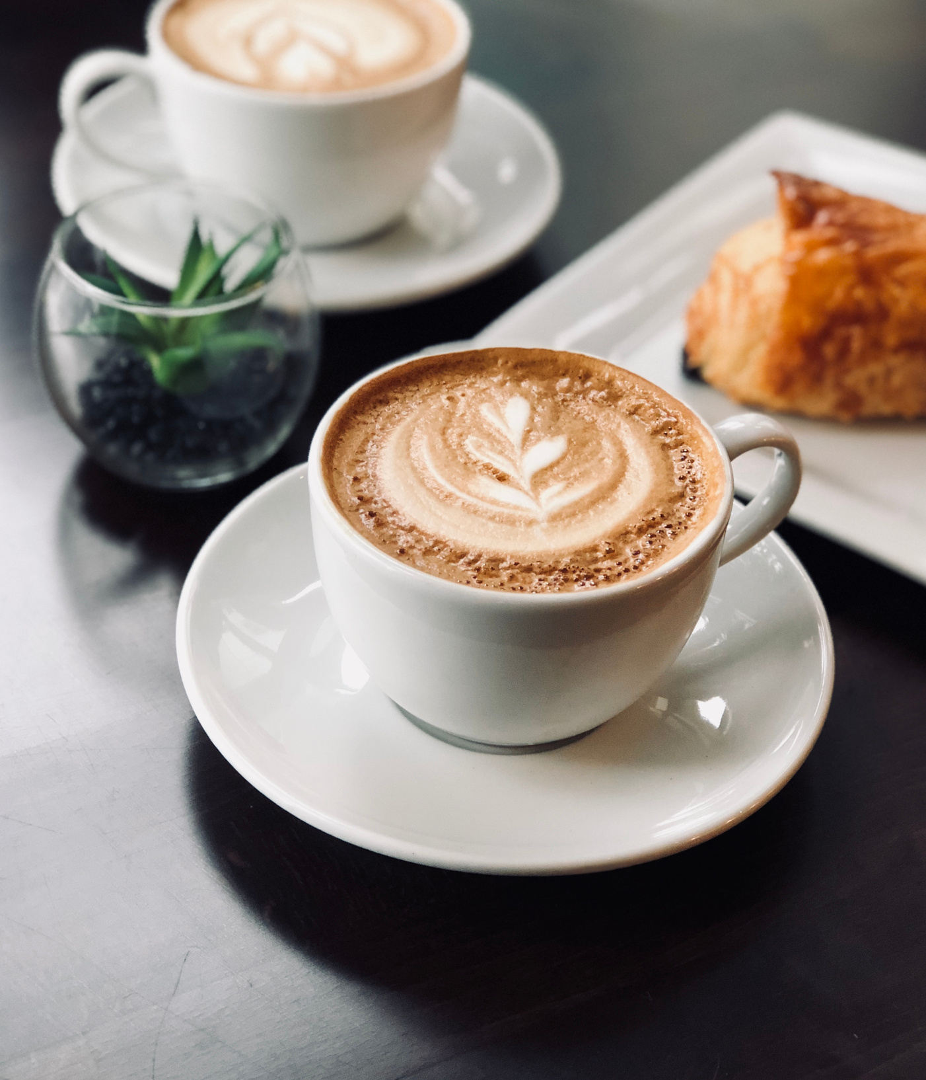
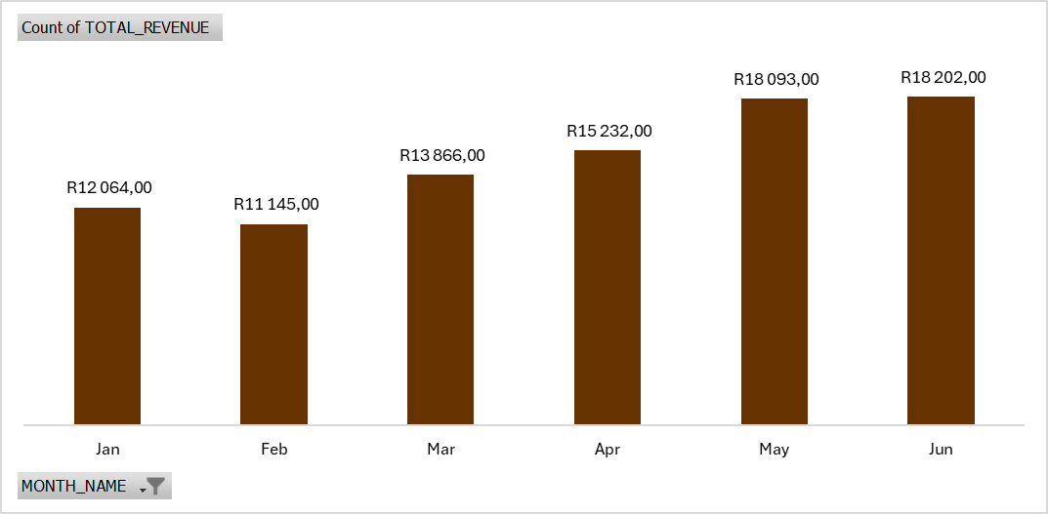
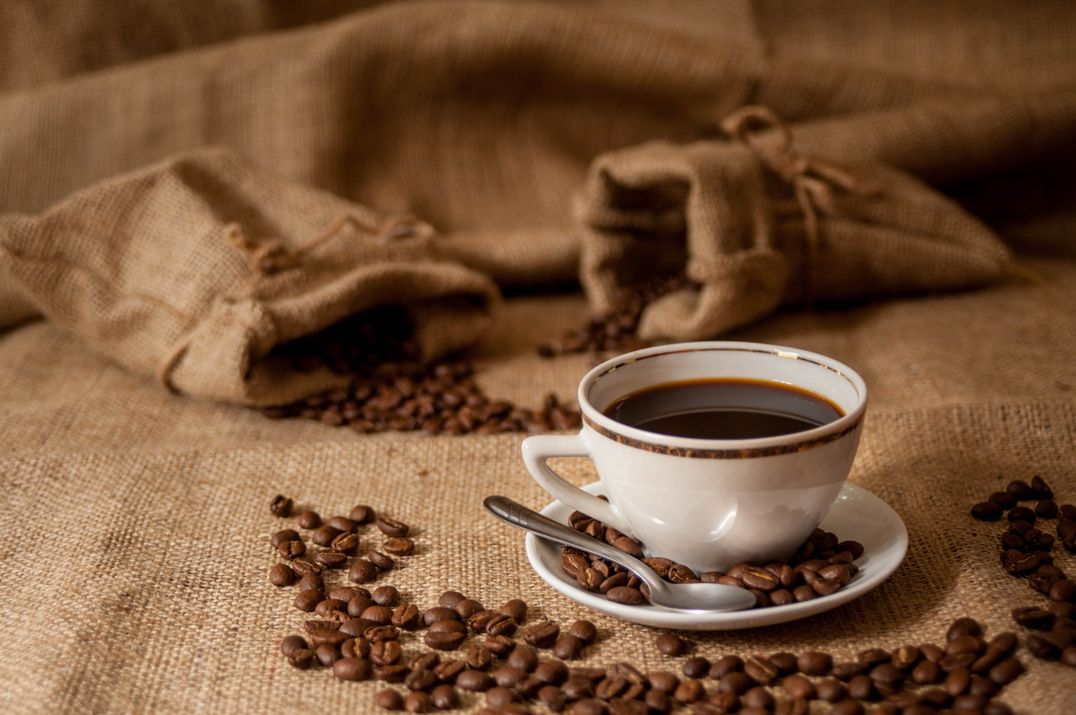
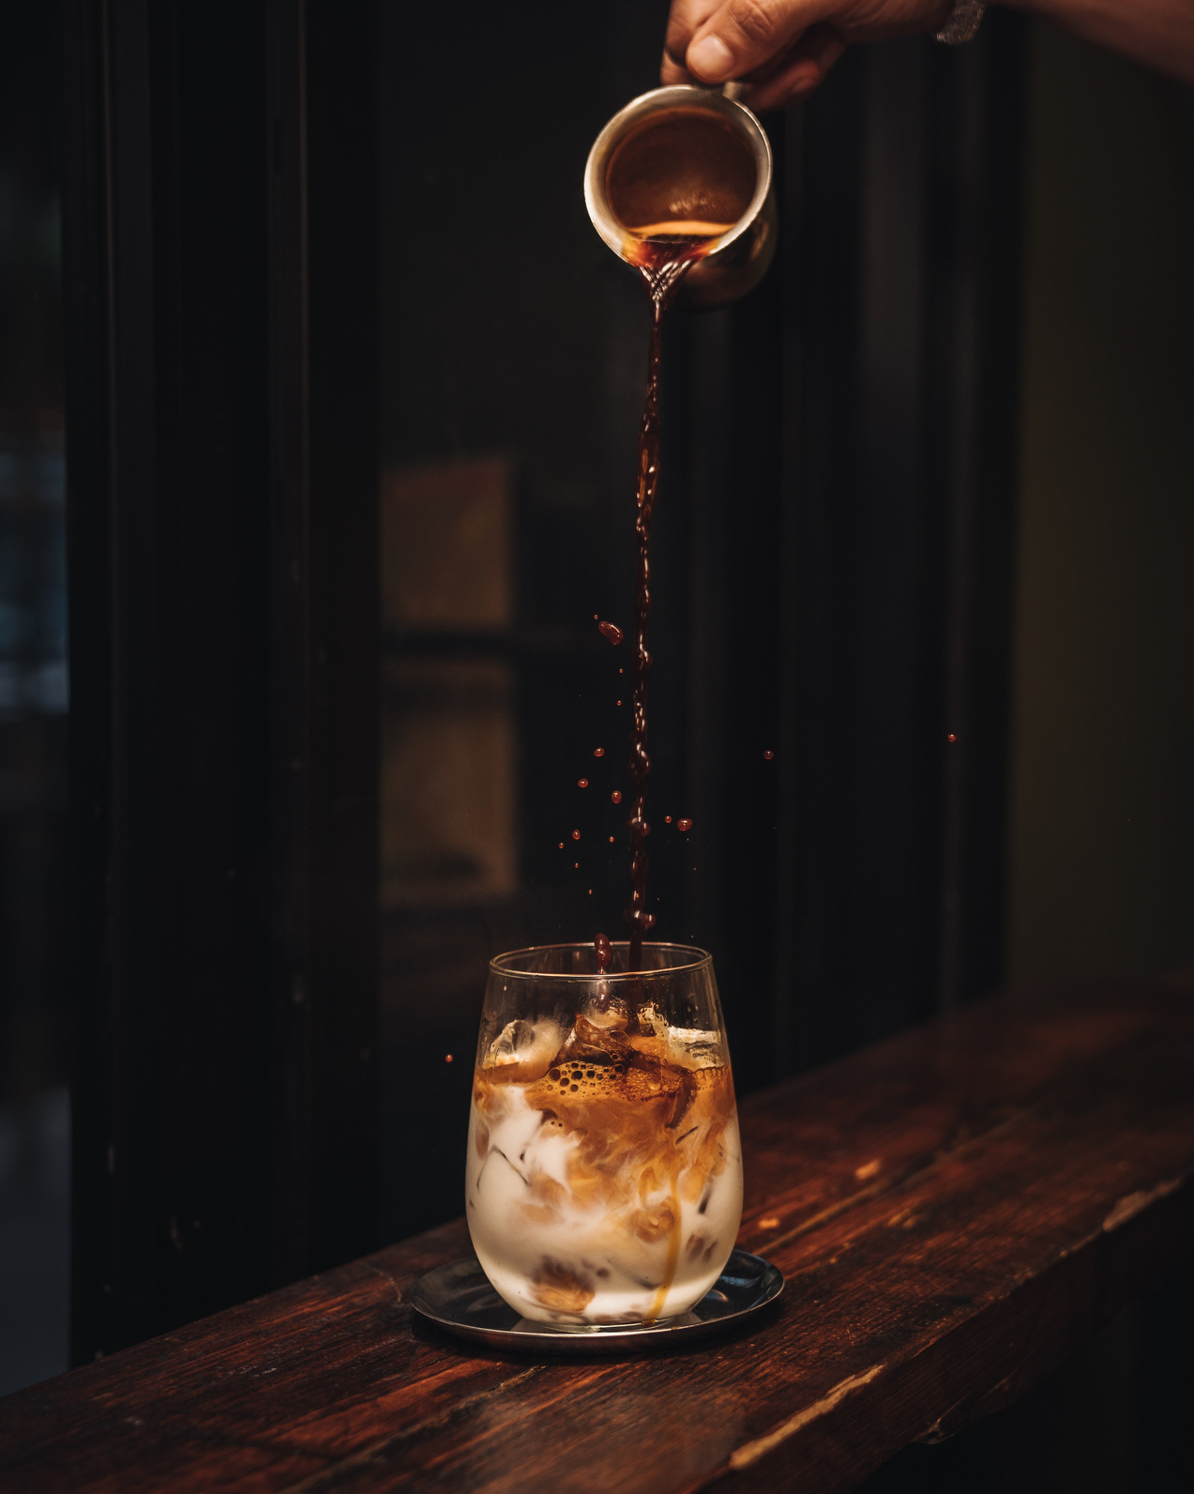
TOTAL REVENUE
R88. 602
Total Revenue over the past 6 months: R88. 602
53% of this revenue was generated in the last quarter (April, May and June).

Slide 5
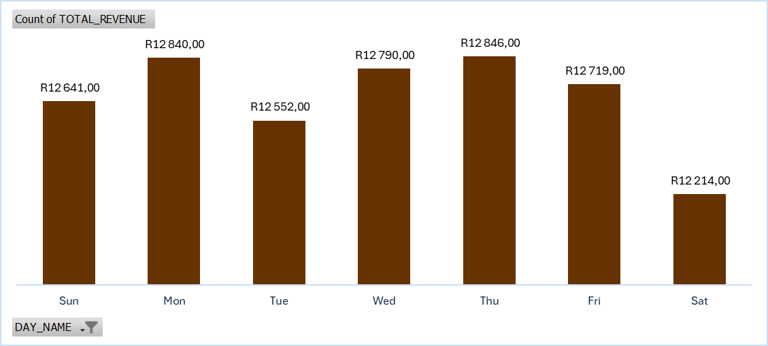
REVENUE DISTRIBUTION BY WEEKDAY
Mondays, Wednesdays, Thursdays and Fridays are the days where we generate most of our revenue (our busiest days).

Slide 6
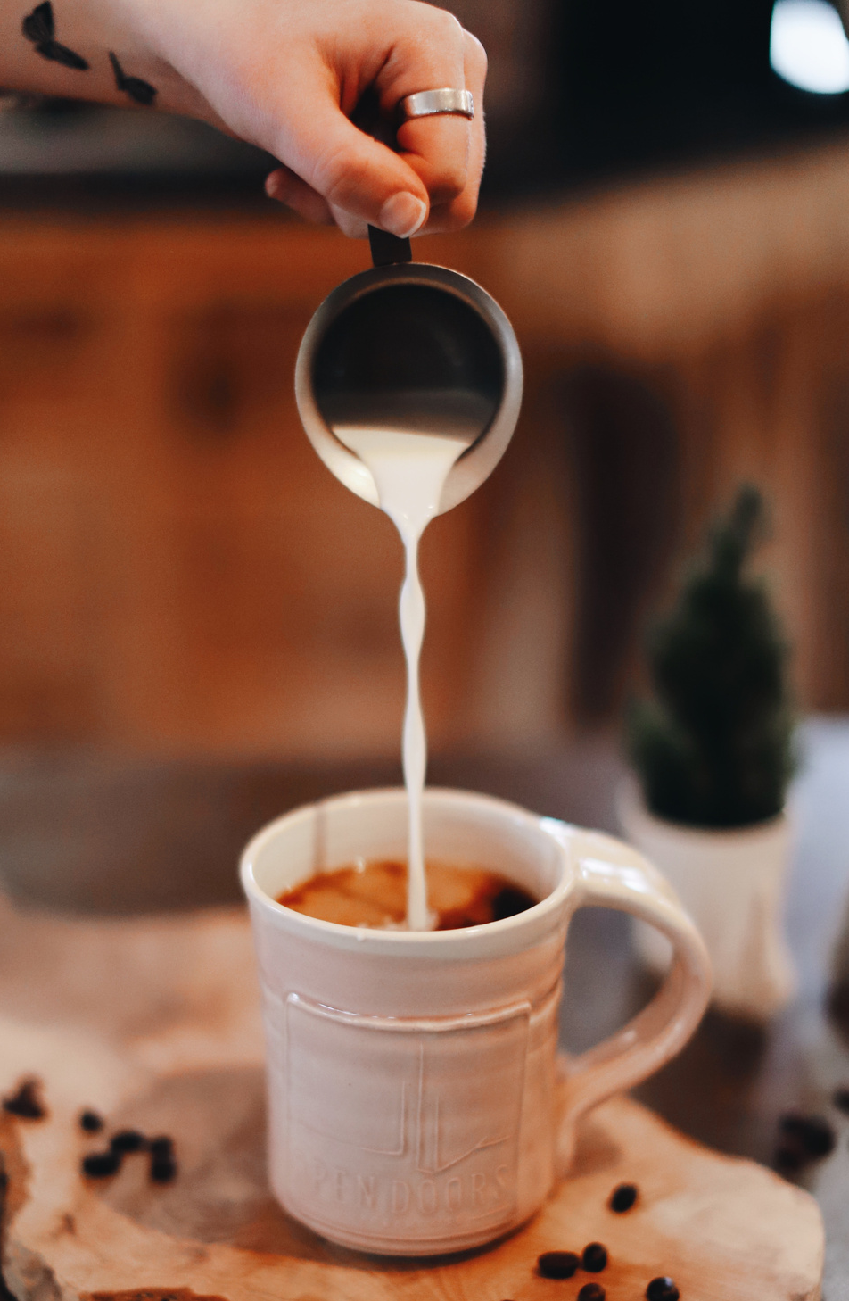
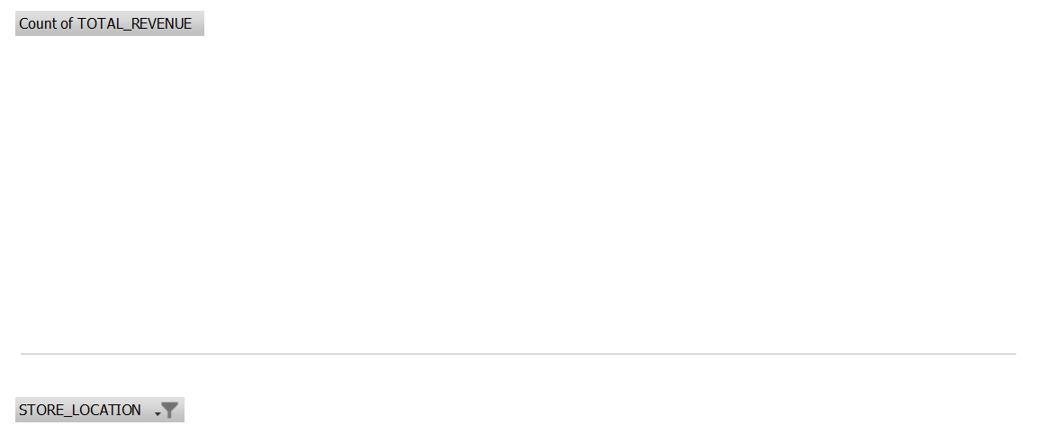
REVENUE DISTRIBUTION BY STORE
34%
34%
32%
Hell’s Kitchen and Astoria are our highest revenue-generating stores bringing in about 34% each of the total revenue of R88. 602
Our Lower Manhattan store however, does not lag far behind, at 32%
Slide 02

Slide 7

SALES
149 116
07
Smells So Good

Slide 8
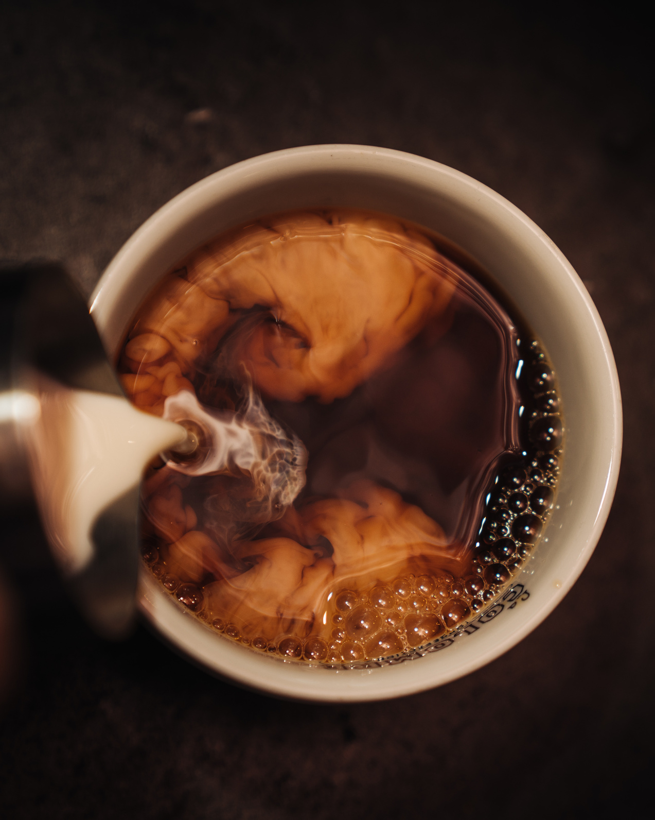
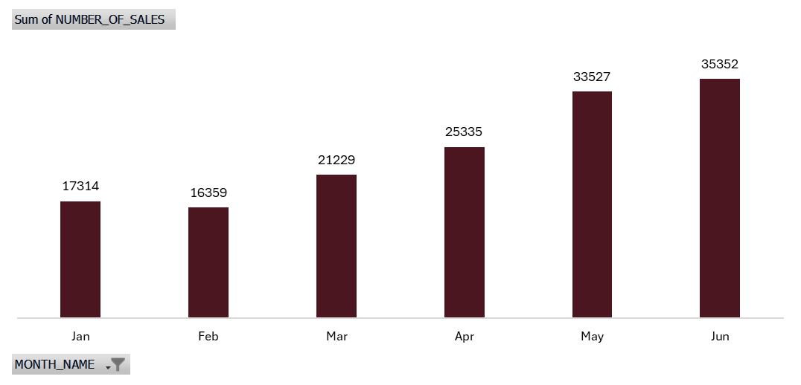
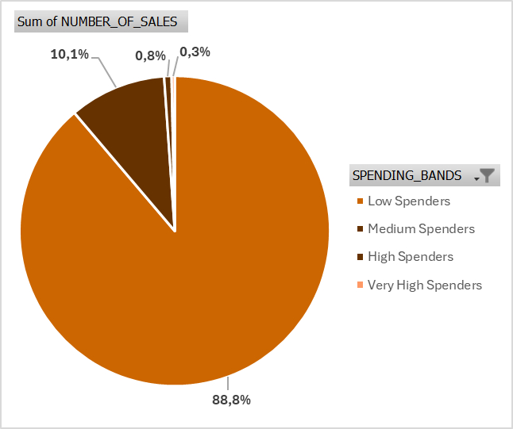
TOTAL SALES
149 116
Mirroring our revenue trend over the past 6 months, more than 50% of our sales were generated during the last quarter (April, May and June).
A majority of our sales are from low spenders, followed by medium spenders.

Slide 9
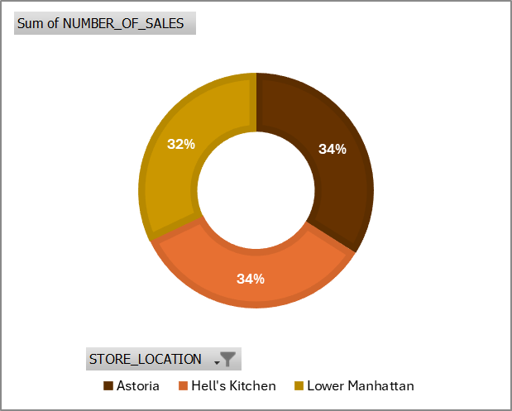
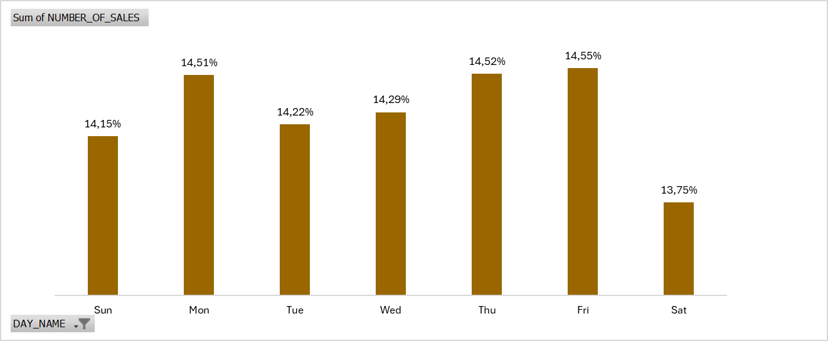
SALES DISTRIBUTION BY WEEKDAY AND STORE
Similarly, Mondays, Wednesdays, Thursdays and Fridays are the days where we generate most of our sales (our busiest days).
Hell’s Kitchen and Astoria are our highest sales generating stores at 34%, followed by Lower Manhatan at 32%.

Slide 10
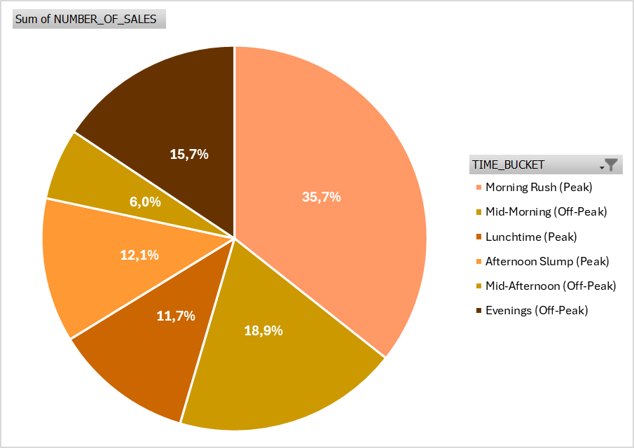
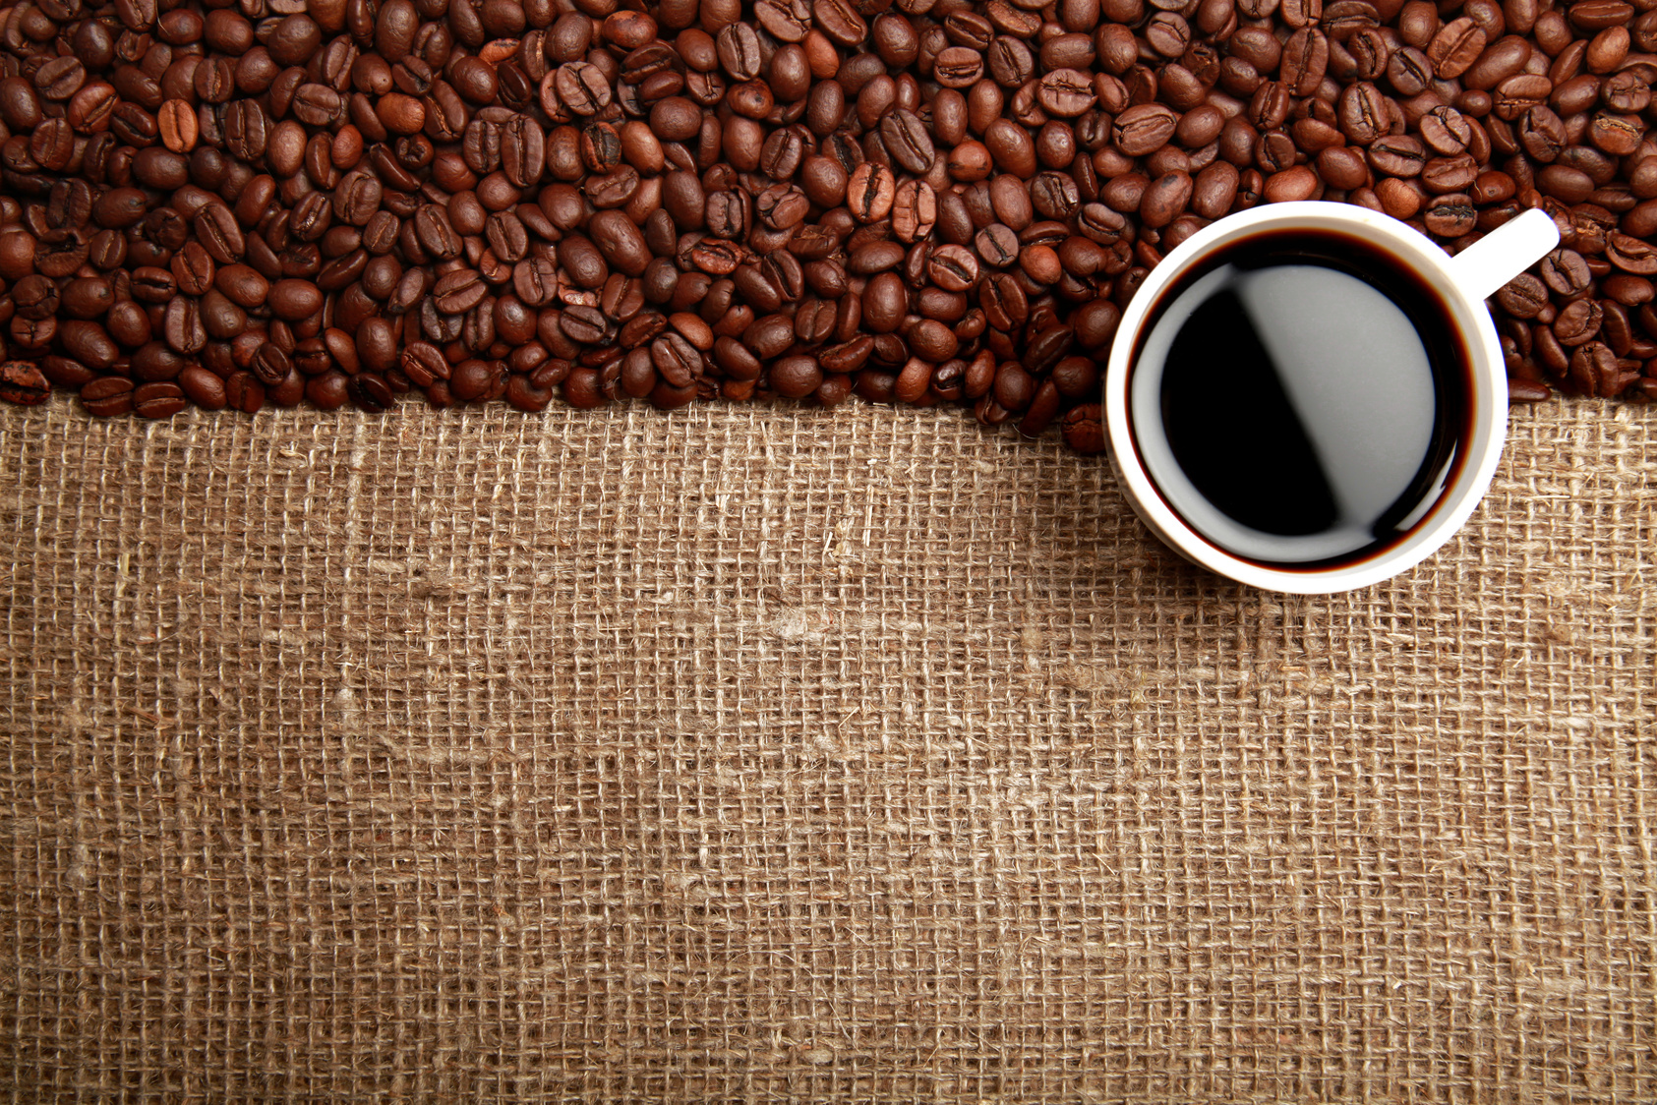
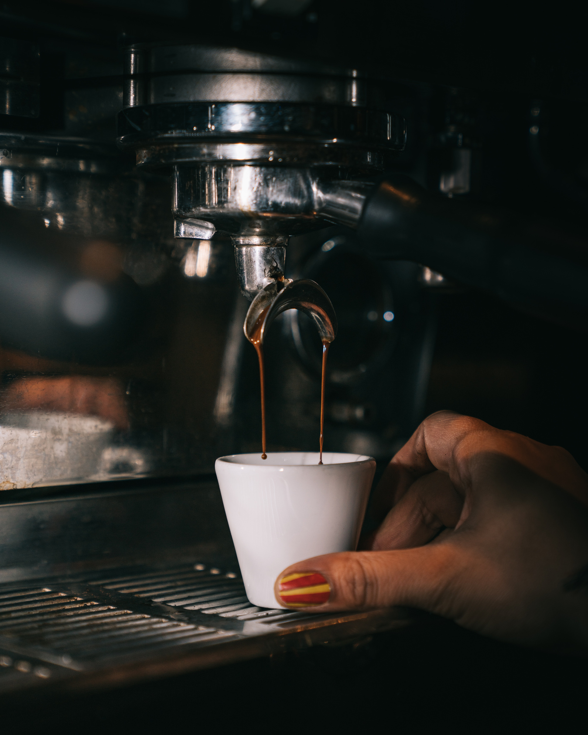
SALES BY TIME DISTRIBUTION
A majority of our sales are generated during the Morning, Mid-Morning, Lunchtime, Afternoon and Evening Hours.
The least of our sales comes from our Mid-Afternoon Hours.

Slide 11
SALES DISTRIBUTION BY TIME
A majority of our sales are generated during the peak morning rush, off-peak mid-morning and evening hours.
Our lowest sales are during lunchtime, the afternoon slump, and off-peak mid-afternoon hours.

Slide 12
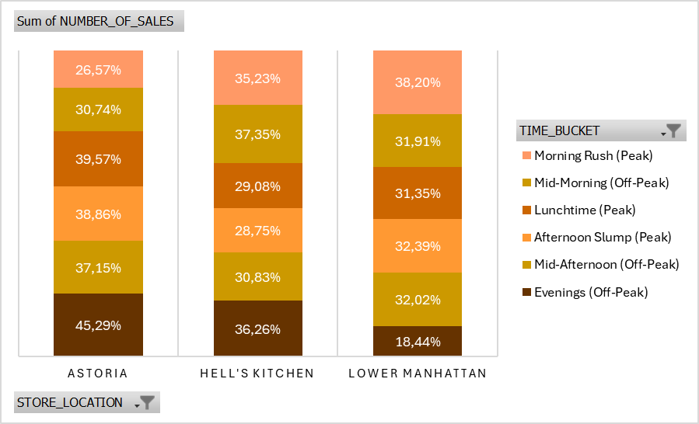
SALES DISTRIBUTION BY TIME AND STORE
A majority of Hell’s Kitchen and Lower Manhattan’s sales are generated during the peak morning rush, off-peak mid-morning hours.
Astoria’s sales are, however, concentrated in the off-peak mid-afternoon, peak lunchtime, and evening hours. Similar to Astoria, Hell’s Kitchen has strong off-peak evening sales.
Lower Manhattan, however, makes most of its sales during the morning and afternoon.

Slide 13

PRODUCTS
149 116
11
Smells So Good

Slide 14
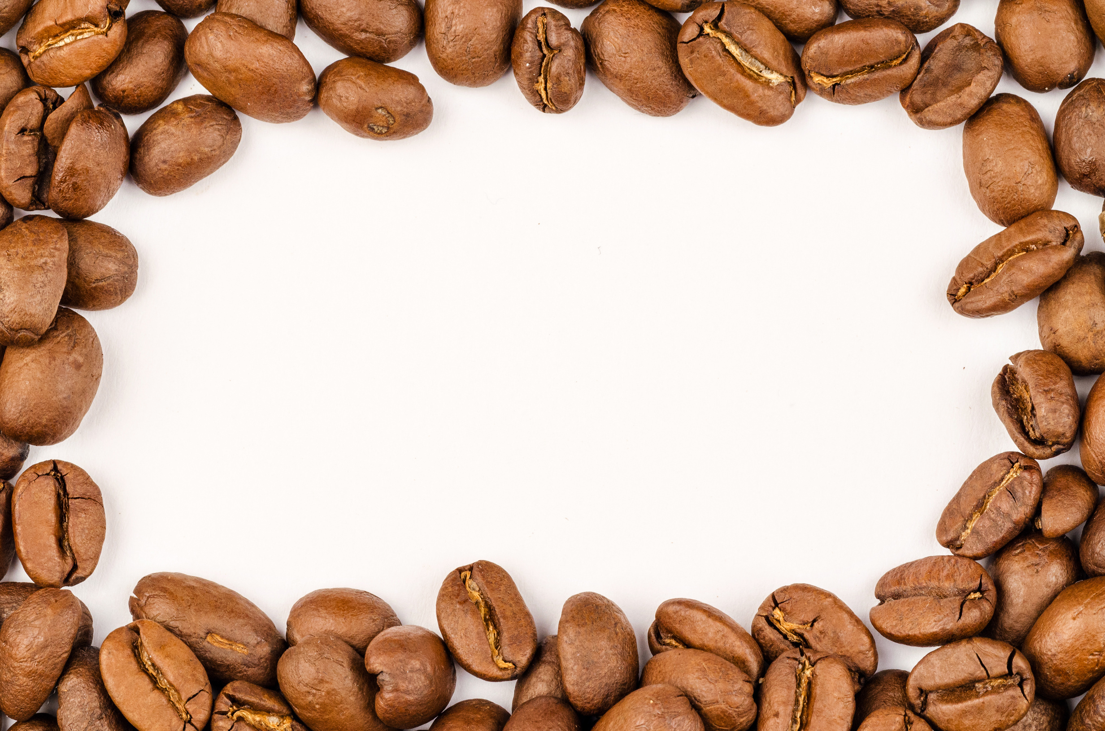
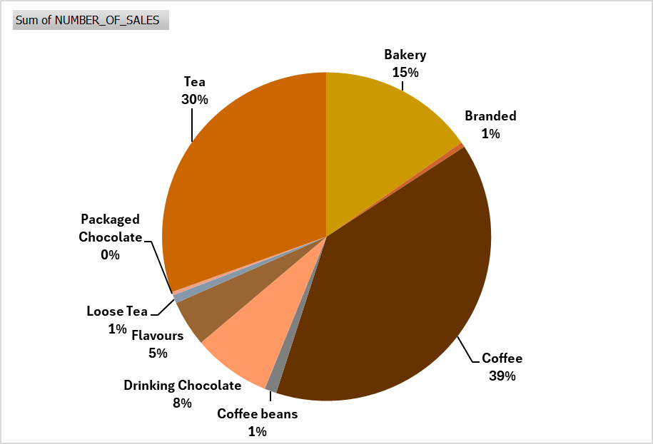
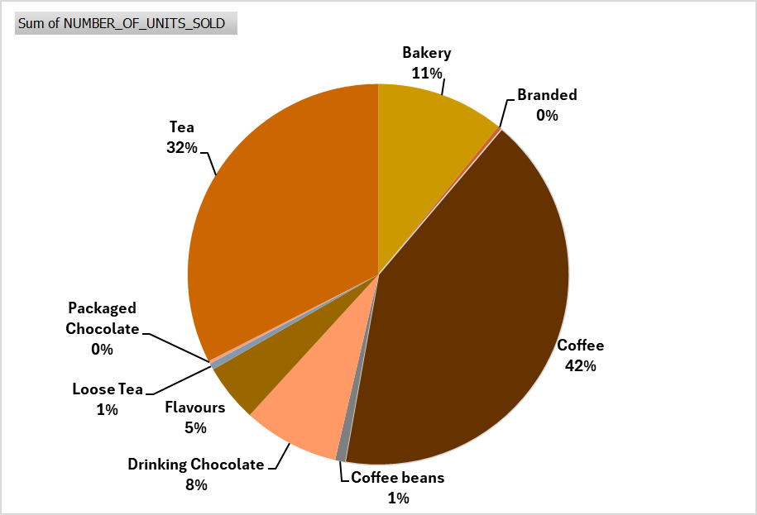
PRODUCTS BY SALES DISTRIBUTION AND NUMBER OF UNITS SOLD
Products by Sales Distribution
Products by Number of Units Sold
In terms of the number of Sales, Coffee, Tea, and Baked Goods are our best sellers.
This is further confirmed in terms of the number of units sold.
Coffee beans, loose tea, and packaged chocolate are, however, our lowest-selling product categories.

Slide 15
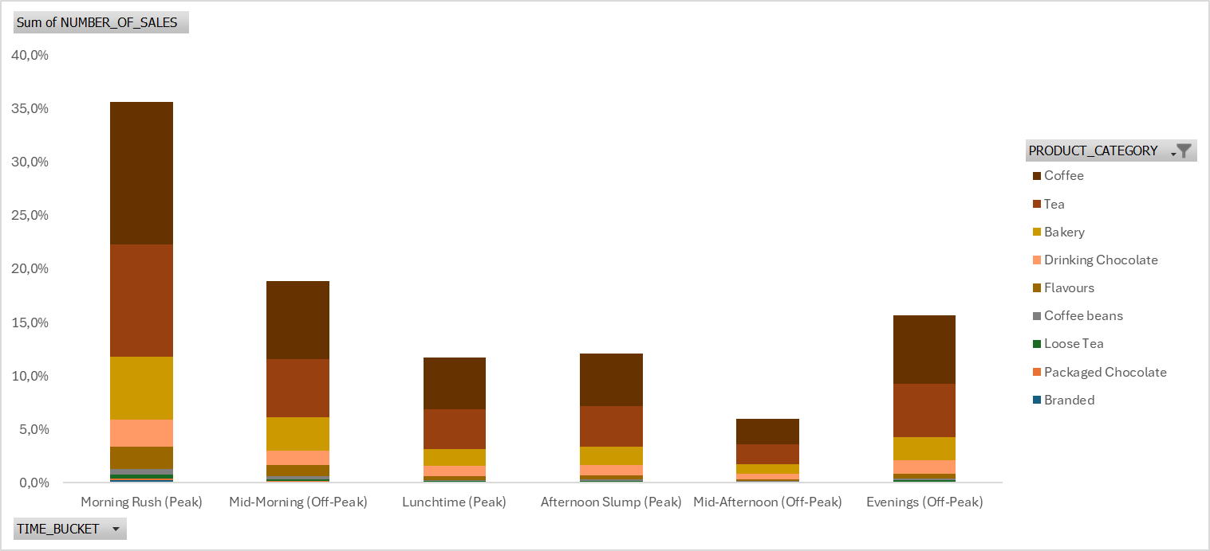
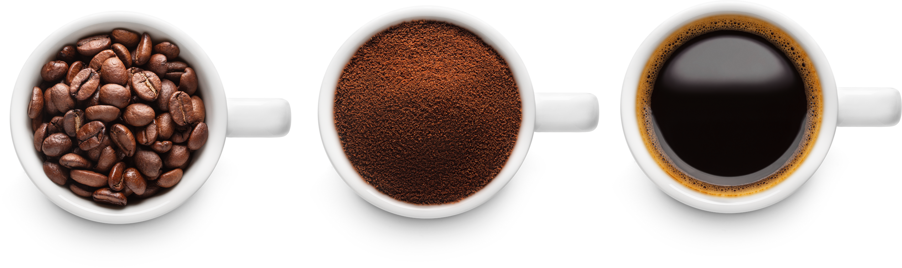
PRODUCTS BY SALES AND TIME DISTRIBUTION
In terms of our busiest times (Morning, Mid-Morning, Lunchtime, Afternoon and Evening Hours).
Coffee, tea and baked goods make up our best-selling product categories. This is also consistent in our least busy times.

Slide 16
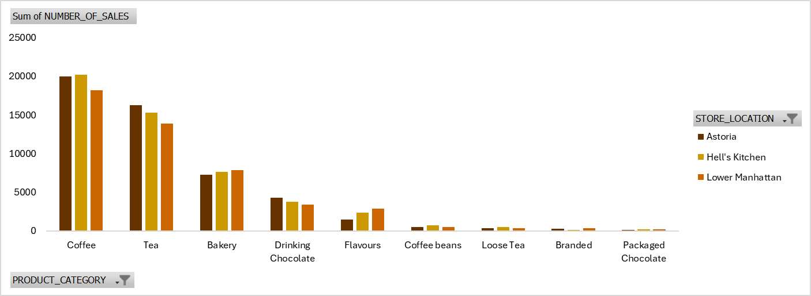
SALES DISTRIBUTION BY PRODUCT CATEGORY AND STORE
Across all three stores, coffee, tea and baked goods are our highest-selling product categories, followed by drinking chocolate and flavours.
Coffee beans, loose tea, branded and packaged chocolate are our lowest-selling product categories across all stores.
Barista Espresso, Brewed Chai Tea, and Gourmet Brewed Coffee are our best-selling products.
Clothing, Organic Chocolate, House Blend Beans, and Green Tea are our lowest-selling products.

Slide 17

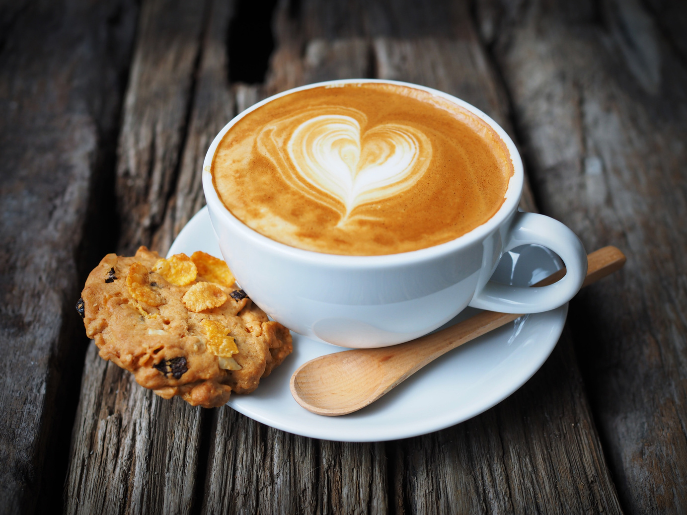
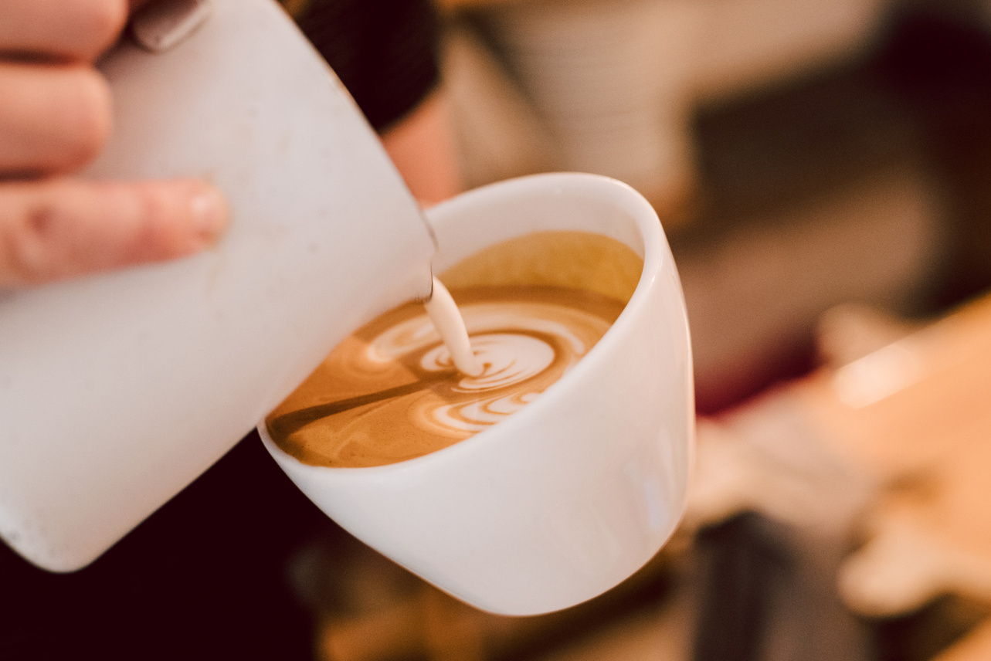
RECOMMENDATIONS
15
Smells So Good

Slide 18



RECOMMENDATIONS
Store Performance
Make coffee shops more attractive. Enhance store interiors to make stores more comfortable and welcoming to encourage increased visits and longer stays. Add additional features such as Wifi and Charging Stations for phones and digital devices.
Host special events on slow days such as open-mike nights, poetry readings, liver performances or book clubs to increase attract new customers and retain existing customers.
Sales and Revenue Performance
Implement a loyalty programme to improve sales and revenue during slow days and off-peak hours.
Increase social media and digital media output during slow days and off-peak hours to encourage customers to visit stores and buy products.
Use influencer marketing and improve online presence.
Product Performance
Maximize on our low lunchtime sales by introducing lunchtime meal items.
Have promotions on slow-moving products during peak hours.
Have promotions on best-selling products during slow days/ off-peak hours.
Experiment with new brewing methods.
Personalize experience by using customer names on products or offering customizable products.

Slide 19
THANK
YOU

